Slide 1
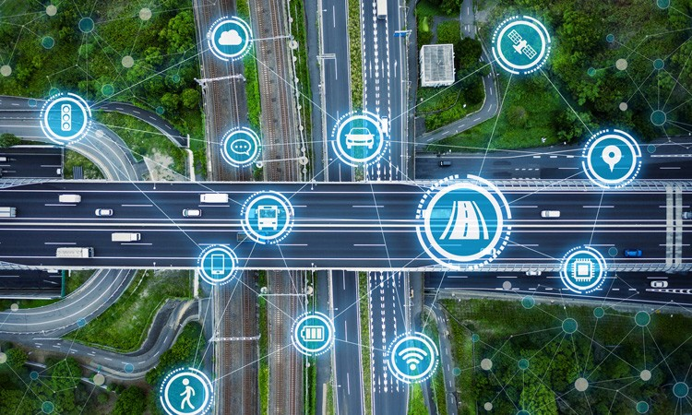
Navigation App
Designing and Prototyping

Slide 2
Overview
Our Navigation App
Design Process
1
2
A mobile application designed to simplify navigation and travel planning with the help of syncing of work tools
Focus on user-friendly design, accessibility, and seamless travel experience.
Journey from ideation to conceptualization.
Transition from low-fidelity sketches to high-fidelity prototypes.
Key milestones and iterations in the design process.
Design Decisions and Guidelines
User Testing
3
4
Overview of the critical design decisions made throughout the project.
Explanation of the design guidelines and patterns followed.
How design principles shaped the app’s interface and functionality.
Insights gained from user testing sessions.
Summary of user feedback and its influence on the final design.
Key improvements made based on testing results.

Slide 3
Design Process
Progression from Ideation to Conceptualization and execution
User Stories
Requirements
Features
Pages
1. As a marketing analyst new to a city, I want a navigation app that provides real-time updates on traffic and transit routes so I can reach my meetings on time without needing to check multiple apps. (Frustration) Addressing my frustration with inconsistent app performance in dense urban areas.
App should provide real-time traffic updates and transit routes
Traffic Heat map
Transit Route Suggestions
Enroute page
2. As a marketing analyst, I want a navigation app that highlights eco-friendly transit options, like walking routes, bike shares, or public transport, allowing me to reduce my carbon footprint. (Goal) To help avoid unreliable travel options and align with my desire for reliable, eco-friendly navigation.
App should provide eco-friendly travel options (bike, walking, or public transport)
Green Route Suggestions
Onset destination page
3. As a marketing analyst, I want my navigation app to integrate seamlessly with my work tools, enabling me to quickly find and save locations related to my tasks without leaving the app. (Frustration) This reduces my frustration with the lack of integration between work and travel tools.
App should be able to Integrate seamlessly with industry work tools
Work Tools Sync
Meeting Navigation
Sidebar
4. As a marketing analyst, I want a navigation app with a simple, clear interface that doesn’t distract me from my work. This ensures that I can use it efficiently without complicated icons or unnecessary features. (Personality) This resolves my pain point around unclear iconography that complicates app use.
App should have a concise and simplistic interface that is not too hard to navigate
Minimalistic Design
Quick Access Widgets
Home page

Slide 4
Design Process
Progression from Ideation to Conceptualization and execution
User Stories
Requirements
Features
Pages
6. As a marketing analyst, I want a navigation app to remember frequent destinations and suggest quick routes based on my past preferences. This will make it faster to get directions for my regular work locations. (Personality) This will minimize setup time, addressing my frustration with spending too much time setting up navigation.
App should provide a list of recent destinations visited and favourite places.
Recent places
Favorites
Search page
8. As a marketing analyst, frequent user of social media and travel-sharing platforms, I want an easy way to share my location or route with my friends and family, so they know where I am during my travels. (Attribute) This allows for seamless location sharing without needing multiple apps, which improves the app's integration with her lifestyle.
(Goal) This helps me minimize time spent coordinating travel and work needs separately, addressing my desire for integration between work and navigation tools.
App should be able to share their location with chosen individuals such as friends or family.
Live Location Sharing
Sidebar
10.As a marketing analyst frustrated by the lack of integration between apps, I want a navigation app to sync with my calendar so that travel time and routes to my meetings are automatically suggested, minimizing time spent on setup. (Frustration) This directly resolves inefficiencies in my workflow.
App should be able to sync with calendar for real-time updates for meetings and emails.
Calendar Integration
Email Integration
Sidebar

Slide 5
Design Process
Progression from Ideation to Conceptualization and execution
User Stories
Requirements
Features
Pages
1. As a farm operator I value privacy, I want a navigation app that doesn’t track or store my location data, so that I can feel secure using it without worrying about my location information being shared. (Personality) Steady, privacy-focused, and distrustful of unnecessary data collection.
App should provide an option for modifying/tracking data of location + provide privacy settings
Data Privacy Settings
Sidebar
3. As a farm operator who is familiar with my local area, I want to verify the accuracy of route offline to avoid needing to rely on online services, especially in areas with poor connectivity.
(Goal) Verify routes independently without needing constant online access.
App should be able to provide high-accurate route suggestions in areas with poor connectivity
Offline Navigation Mode
Offline Mode
4. As a farm operator who lives in rural areas with inconsistent internet, I want an app that reliably provides directions even offline or low signal, so I’m not stranded without guidance if I’m outside the coverage zone. (Frustration) I often navigate apps that stop working in remote areas, leaving me without reliable guidance when I need it most.
App should be able to provide high-accurate route suggestions in areas with poor connectivity
Offline Navigation Mode
Offline mode
5. As a farm operator I want the ability to control what information I receive so that I only get updates on things that are important to me without sharing unnecessary data with the app. (Goal) Only receive essential notifications without the app accessing excessive data.
App should give the user an option to customize any notifications they receive
Notification Customization
Profile

Slide 6
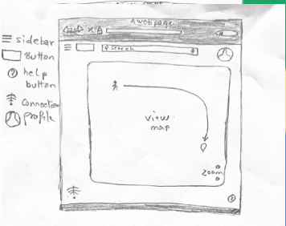
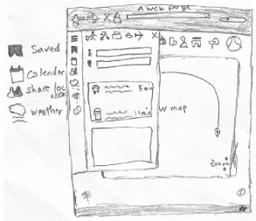
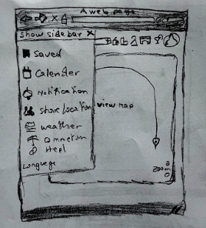
Transition from Low Fidelity to High Fidelity Design
To be discussed
xxxxxxxxxxxxxxxxxxxxxxxxxxxxxxxxxxxxxyyyyyyyyyyyyyyyyyyyyyzzzzzzzzzzzzzzzzzzzzzzzzzzzzzzzzzzzzzzzzzzzzzzzzzzzzzzzzzzz

Slide 7
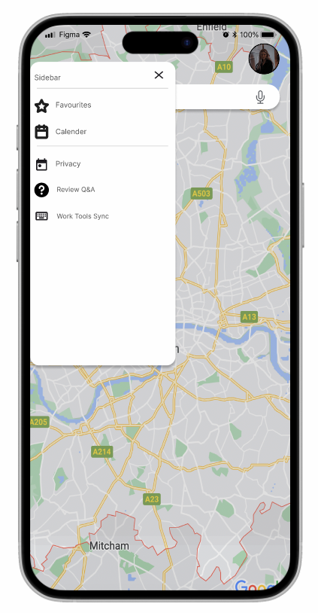
Transition from Low Fidelity to High Fidelity Design
To be discussed
xxxxxxxxxxxxxxxxxxxxxxxxxxxxxxxxxxxxxyyyyyyyyyyyyyyyyyyyyyzzzzzzzzzzzzzzzzzzzzzzzzzzzzzzzzzzzzzzzzzzzzzzzzzzzzzzzzzzz

Slide 8




Design Decisions Made
Our app’s is centered around usability, clarity, and efficiency. as a group we decided to follow these UX/UI principles:
User-Centric Design
Minimalist Interface
Color Coding
Prioritizing quick access to critical information such as location, navigation, and traffic data.
Keeping the interface clean and uncluttered despite a wealth of features.
Using intuitive colors to differentiate elements (Stroop effect)

Slide 9



Design Guidelines Followed
Our App adheres to established design principles to ensure usability and accessibility:
Accessibility
Consistency
Ensuring the app is accessible to all user base by offering easy to read text , color contrast, and large tappable areas.
Uniform design language across pages to maintain familiarity for users.

Slide 10






Design Patterns Used
Our App employs various design patterns to ensure functionality and ease of use:
Map Interaction Pattern
Overlay Pattern
Dynamic Information Cards
Dragging for panning, pinch-to-zoom, and tilt-to-view offer direct manipulation of the map.
Overlays for search results, directions, and nearby points of interest to avoid obstructing the main map.
The sliding panel at the bottom offers secondary information while maintaining focus on the map.
Expandable cards at the bottom give detailed route or place information without overwhelming the main interface.
Contextual Menus
Sustainability Focus
Right-click menus (desktop) or long-press options (mobile) allow access to contextual actions, like saving or sharing a location.
Highlighting eco-friendly routes to reduce environmental impact.

Slide 11
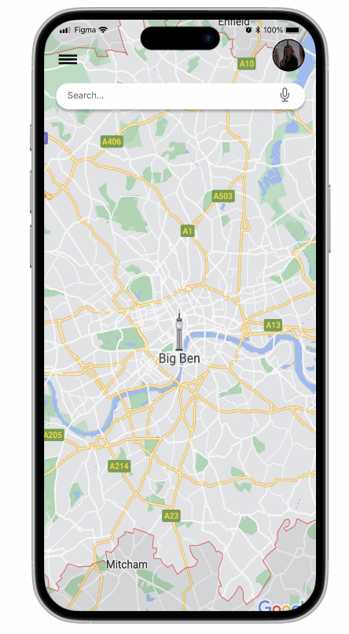
Design Decisions and Guidelines
“ Our aim is to create a seamless navigation app with additional features but while navigating we decided to focus on navigation only and side-line our other features “
How to make sure the user focuses on the ‘correct’ or important stimuli?
How to make sure the user understands the stimuli that has their attention?
Key information (e.g., the current route and next turn) is displayed prominently in the navigation interface, often at the top or centre of the screen.
Secondary details (e.g., alternate routes, ETA) are placed in less visually dominant areas, like sidebars or smaller text.
Use contrast (color, size, and font weight) to highlight critical stimuli, such as the next turn or alerts like "Accident Ahead.“
Ensure less relevant information is visually subdued, guiding the user's focus naturally.

Slide 12

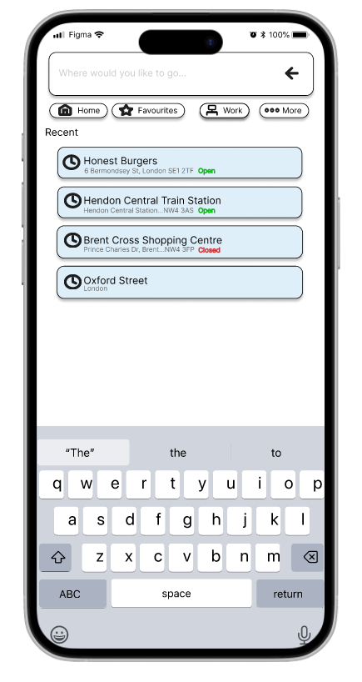
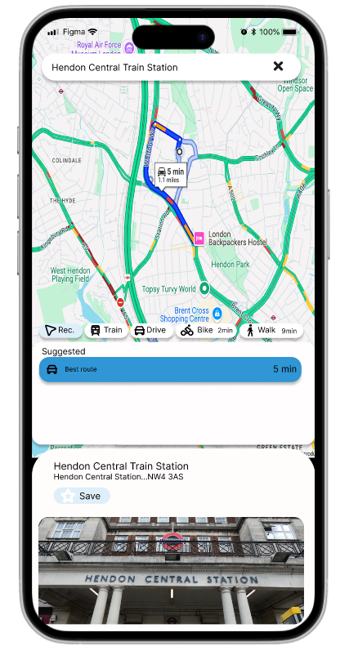

Concept of Chunking
Chunking is a memory technique that involves breaking down large amounts of information into smaller, more manageable units called chunks which makes it easier to retain information in the short-term memory.
Use case of Chunking theory in our app
We used recognition instead of recall, that's why we heavily used icons and colours in such a way that the user recognises our features quickly and easily.
The magical number
Examples of where we have used this usability principle
Recent Searches
+
Example: Our App displays a list of recently searched locations. Users don’t need to recall previously searched addresses; they can simply select them from the list.
-
2
Saved Places
Example: Places marked as "Favourites," "Work," or "Home" are visually represented with icons or labels on the map. Users can recognize these spots without re-entering their addresses.
George Miller's chunking theory
is based on the idea that short-term memory can hold between 5 and 9 chunks of information.
Color-Coded Traffic and Routes
Example: Traffic conditions are indicated with recognizable colour codes (e.g., green for free flow, red for heavy traffic). Users instantly understand the situation without needing to interpret detailed text.

Slide 13




Post Completion Error
Post-completion error is an error where a user misses the steps of a task that are not directly related to the goal and have to be completed after the goal has been reached.
Possible Post Completion Error Example in our App
“Forgetting to End Navigation”
When users reach their destination while using Our App or a navigation app, they may forget to manually stop the navigation.
This oversight leads to the app continuing to track their location, reroute if they move, and display directions unnecessarily.
Consequences
Battery Drain
Resource Utilization
Data Usage
User Frustration
GPS and other location services consume significant power.
Apps often rely on real-time data to update traffic and routes, consuming mobile data.
The device's processing resources remain engaged, possibly slowing other functions.
If left running, users might receive notifications or hear prompts when not needed.
This problem arises because users focus on their primary task (reaching the destination) and may not pay attention to secondary tasks (stopping the navigation).

Slide 14
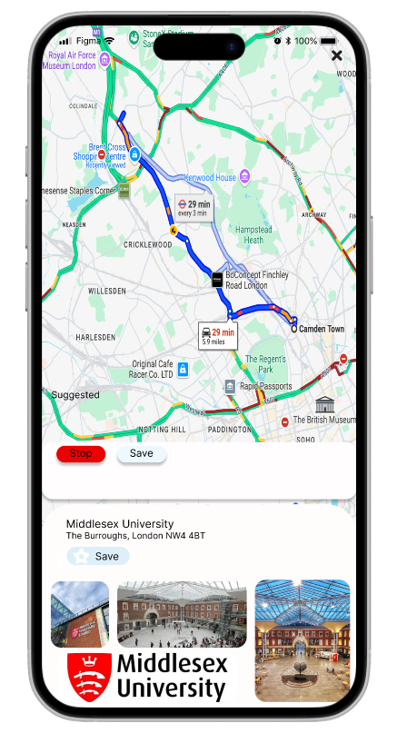
Our Solution to ‘Forgetting to end navigation’ Error
“End Navigation Shortcut Button”
We have added an easy-to-access button or swipe gesture for stopping navigation directly from the app's main screen or lock screen widget.
This reduces friction for users, encouraging them to stop navigation manually.

Slide 15
The Stroop Effect
The Stroop effect was first described by American psychologist John Ridley Stroop in the 1930s.
“The Stroop effect is a psychological phenomenon that describes the delay in reaction time when there is a conflict between language and color information”.
Use case of the Stroop Effect in our app
Color Coding
Stroop Effect Insight
When a text label or object has a colour that does not match its meaning, users experience a delay in processing (e.g., the word "blue" written in red).
To avoid confusion, Our App aligns the colour of map elements with their expected associations.
Application in Our App
Traffic Indicators
Traffic conditions are represented using universally understood colours.
For e.g. green for smooth traffic, yellow for moderate, and red for heavy.
This minimizes cognitive dissonance and ensures users quickly interpret the information.
Landmarks and Terrain
Parks are green, water bodies are blue, and roads are grey or black, adhering to common associations to streamline user comprehension.
“ Inconsistent cues—like a green button labelled "Cancel"—can cause hesitation “

Slide 16
To be discussed
(display our low fidelity sketches and the brains behind it
what is the design?
why that design ?
how we designed?
deifning workflow ( refer to slide 23 from week 6a)
creating a navigation model
talk about the user stories we picked from both the personas to define the requirements of the apps which led to the features of the app
how we created our flow of the app?
Which users/personas you will be designing your flows for?
ans - we took both of our personas into considerations when designing the flow of our app ( primary and secondary and used theri user stories as an inpiration of our app
What user and business objectives need to be accomplished
ans - the objectives were ( list of features ) and end goals
whats the basic flow of an user when using our app
create a flow chart refering to slide 30 of week 6.
also create a detailed flowchart explaing different tasks user can do with our app (refer slide 31)
ex. work tools sync
calendar sync
sharing location
offline maps
privacty settings related
create a wireflow design and explain it
refer slide 32
represent all the info we have in a flowchart displyed on slide 34
create a low fidelity wireflow refer page 35

Slide 17
User Testing
Purpose of the Test
The test aims to evaluate the usability, functionality, and overall user experience of the app.
Specific goals include
Identifying pain points in the user interface.
Testing specific features and workflows.
Checking if the system meets user needs.
Gathering feedback to prioritize improvements.
Check if our system is as good as the one we are comparing it to.
Test Setup
We developed tasks that mimic real-world use cases of the product for our users.
We ensured the testing environment was conducive to focused and unbiased feedback (e.g., minimal distractions, and access to required tools).
We encouraged our users to use the Think Aloud Protocol to understand their feedback better.
We prepared data collection tools (notepad) to enter user inputs.
Test Conduct:
We began with an introductory session explaining the purpose of the test and assuring users that it’s the product, not their skills, being evaluated.
Guide users through the tasks, observing how they interact with the product.
Avoid offering excessive help to allow natural user behavior.
End with an extra interview post-task to gather additional feedback.

Slide 18
User Testing
Type of Data Collected
Quantitative Data:
Task completion rates.
Time taken to complete specific tasks.
Error rates or number of mistakes.
System usability scale (SUS) scores.
Likert Scales
Qualitative Data:
Observations of user behavior (e.g., hesitation, frustration, confusion).
Verbal feedback during the test (e.g., "thinking aloud" protocol).
Open-ended feedback collected during debriefing.

Slide 19
User Testing
Transcript
Test Person 1 Name: Jhanvi E-mail address: jhanvi18@gmail.com Occupation: Freelancer Education level: Arts Graduate Computer literacy: Moderate
Task description – Navigate to Hendon Central Station by car from the home page.
19:00 | Introduction of the user Reading task description
19:06 19:07 19:09 19:10 19:11 | Click on the search tab and search “Hendon Central Station” in the recent section. “This design and options are very familiar to what I use in my day-to-day life, easy to navigate” Clicks on Hendon Central Station and looks through the options provided. “I like how you gave multiple modes of transportation, but I can’t see any bus option as I like to travel by bus, your app is showing me how much time I’ll take which is great, and also I appreciate it shows me if I have any traffic on my way “ Clicks ‘best route’ option and starts navigation. “Great transitions but I’d like a zoom-in on my current location as I would like to see the turns I need to make.” Stop the navigation by clicking the end shortcut button. “I would like to see a notification on the app telling me that I have reached, but I like how the app has given extra information about Hendon Central Station at the bottom.” Clicks the cross arrow and returns back to home “That was simple and easy to navigate.”
19:12 | Task -1 finished Successfully

Slide 20
User Testing
Transcript
Test Person 1 Name: Mohammed E-mail address: moali676@gmail.com Occupation: Lawyer Education level: Law Graduate Computer literacy: Advanced
Task description –Navigate to Honest Burgers by car from the home page.
19:00 | Introduction of the user Reading task description
19:06 19:07 19:09 19:10 19:11 | Click on the search tab and search “Honest Burgers” in the recent section. Clicks on Hendon Central Station and looks through the options provided. Clicks ‘best route’ option and starts navigation. Stop the navigation by clicking the end shortcut button. Clicks the cross arrow and returns to home
19:12 | Task -1 finished Successfully

Slide 21
User Testing
Transcript
Test Person 5 Name: Richard E-mail address: Rich29@gmail.com Occupation: Software Engineer Education level: Bsc Computer Science Computer literacy: Advanced
Task description – Share Location with your Mom
19:00 | Introduction of the user Reading task description
19:06 19:07 19:09 19:10 19:11 | Click on the Sidebar tab next you will look through five option. “The option seems bit different and complicated as compared to other maps” Click on Privacy and look through the options provided. “I feel like there are too many steps for sharing location, there should be direct option.” Click on Location Sharing Option and it will take you to the Contacts suggestion. “This is easy and very familiar to me and it also gives close contacts suggestion so I don’t need to go through all my contact list it also gives option how long I want to share my location for, which is far better from other apps. ” Click on the Person you want to share location with (Mom) and click share. “Easy to share location but too many steps ” Clicks on the Back arow to returns Home. “Easy to navigate back ”
19:12 | Task -5 finished Successfully

